Slide 1
Cancer Labels Extraction and Notes Processing
Abdullah Bin Faiz
Arbaz Khan Shehzad
Asad Afzal
Momin Tariq
Muhammad Siddiqi
AIMed - AI Department
CDR
April 16, 2024

Slide 2
Asad Afzal
Work Done till CDR

Slide 3
Problem Statement
Data Sourcing & Analysis
Pre-processing Pipeline
Input Text Processing
Chunking Flow
Prompt Engineering
Post-Processing & Results
Future Works
Agenda

Slide 4
Section 1:
Problem Statement

Slide 5
Problem Statement
“Requirement of cancer diagnosis label extraction
from EHR Provider Notes using LLMs.”
- Steps:
1. Not to go for direct extraction of cancer labels
2. Focus on factors directly related to cancer diagnosis
3. Focus on quality of predictions to avoid missed cases, hallucinations, faulty outputs

Slide 6
Problem Statement
Key Decisions:
1. The factors related to cancer diagnosis labels are identified as:
- Progression of cancerous disease
- Toxicity of disease
- Hospice care / death
2. Text related to these factors would be used to get JSONs
3. Utilization of chunking flows to accommodate large provider notes

Slide 7
Section 2:
Data Sourcing and Analysis

Slide 8
Data Sourcing
- The data was sourced from a MongoDB, which was stored via PySpark.
- Five major cancer types, with there patients and notes are given as:
Cancer Type | ICD-10 Code | No. of Patients | No. of Notes
Colon Cancer | C18 | 2,023 | 42,509
Lung Cancer | C34 | 2,847 | 56,585
Blood (plasma cell) Cancer | C90 | 1,237 | 38,216
Breast Cancer | C50 | 5,324 | 91,658
Prostate Cancer | C61 | 2,619 | 47,348

Slide 9
Data Analysis
Removal of rows with provider notes featured as:
Null values
Duplicates
Focus only on the breast cancer patients having about 90k notes, of 5k patients
Metadata storage in JSON file useful, for quick analytics regarding a practice
Graphical representation of:
Distribution of Patients across practices
Distribution of Notes across practices
Distribution of lengths of tokenized notes
Violin Graph for distribution and percentile analysis

Slide 10
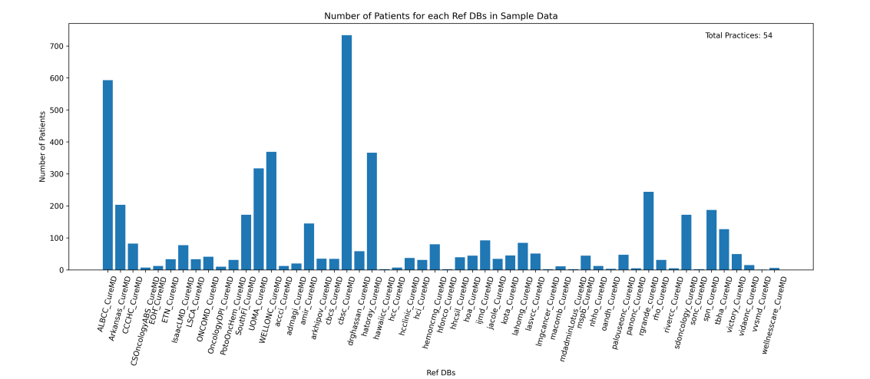
Data Analysis

Slide 11
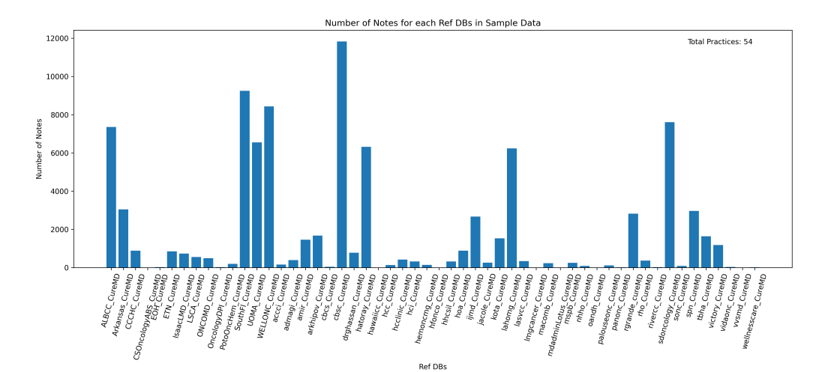
Data Analysis

Slide 12
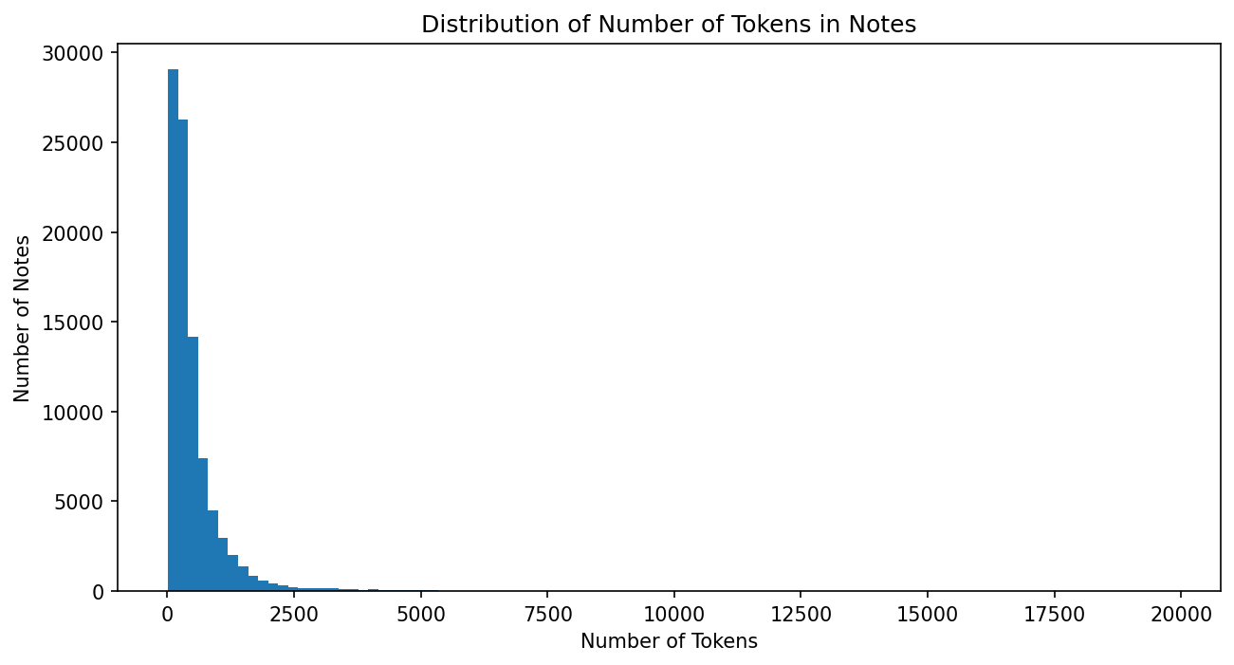
Data Analysis

Slide 13
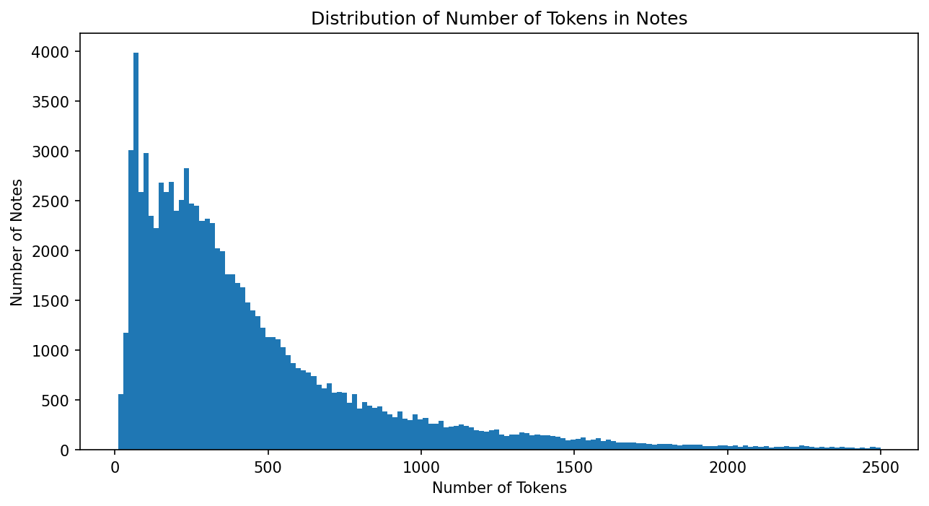
Data Analysis

Slide 14
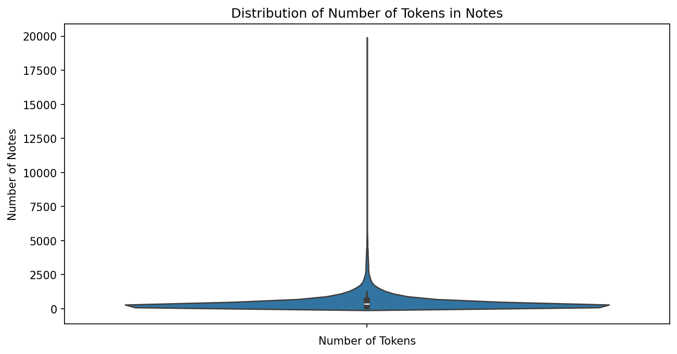
Data Analysis

Slide 15
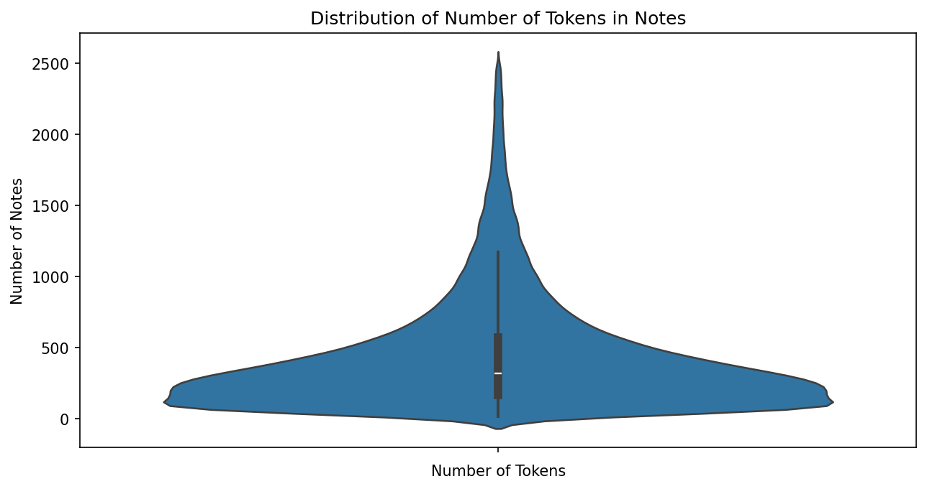
Data Analysis

Slide 16
Section 3:
Pre-processing Pipeline

Slide 17
Pre-processing
Following steps are utilized during the pre-processing of provider note:
- Removal of Sections via HTML tags matching:
Review of Systems
Physical Exam
Vital Signs
Removal of HTML tags via Beautiful Soup HTML parser
Removal of Non-ASCII tags
Removal of Short Lines (less than five words separated by whitespace)
Removal of repetitive text already present in previous two notes
Referred as Differential Text

Slide 18
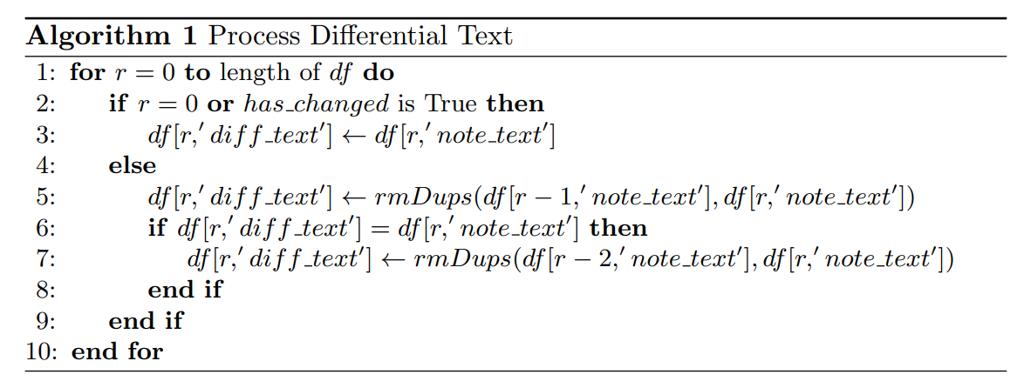
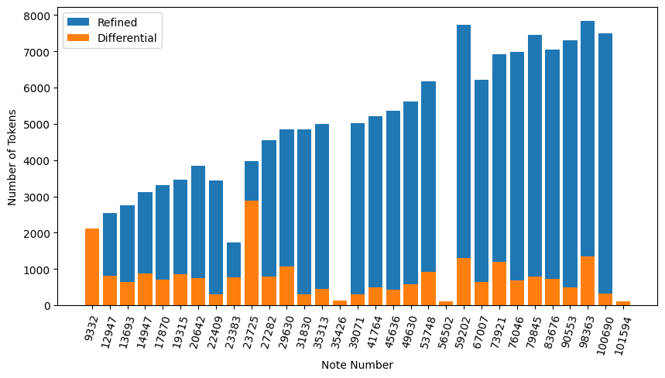
Pre-processing

Slide 19
Pre-processing
- Pre-processed text significantly reduces the size of input text, helps in
Cleaning of text to avoid non-rendered text
Removal of irrelevant text from the notes
Removal of redundant information already processed
Pre-processed text helps in reduction of input tokens given to LLM, helps in quality of outputs as suggested by “Needle in the Haystack benchmark”
Pre-processed data is stored in MongoDB, or in CSV file to avoid DB calls

Slide 20
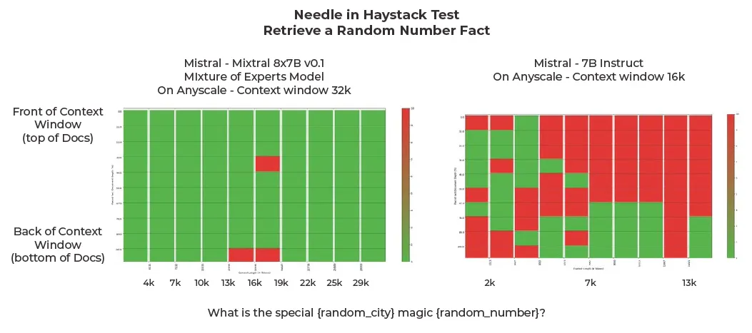
Pre-processing

Slide 21
Section 4, 5:
Tokenization and Chunking Flow

Slide 22
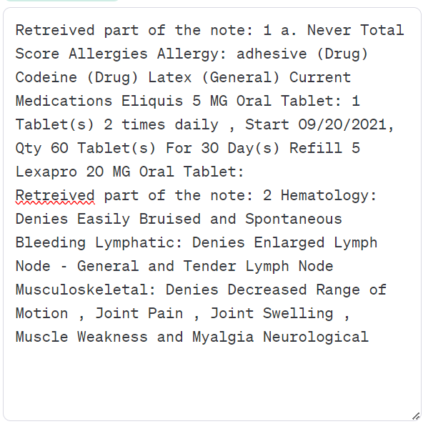
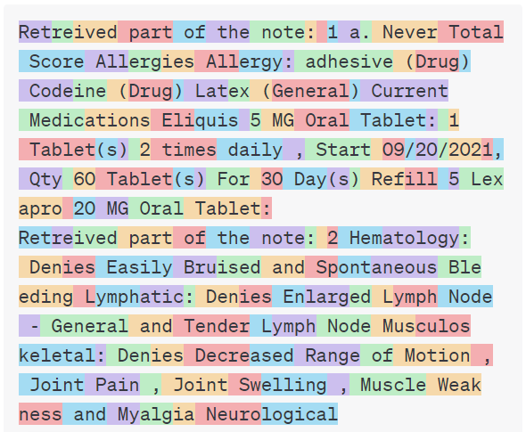
Tokenization
Characters to Tokens conversion:
Characters (558) ---> Tokens (161)

Slide 23
Tokenization
Characters to Tokens conversion:
Characters (558) ---> Tokens (161)
[12289, 265, 2270, 961, 315, 279, 5296, 25, 220, 16, 264, 13, 15037, 10884, 18607, 2052, 2431, 552, 2052, 43043, 25, 65558, 320, 78893, 8, 6247, 483, 320, 78893, 8, 10128, 327, 320, 15777, 8, 9303, 12851, 811, 34362, 9383, 220, 20, 52292, 54501, 58403, 25, 220, 16, 58403, 1161, 8, 220, 17, 3115, 7446, 1174, 5256, 220, 2545, 14, 508, 14, 2366, 16, 11, 77657, 220, 1399, 58403, 1161, 8, 1789, 220, 966, 6187, 1161, 8, 8718, 484, 220, 20, 27917, 59948, 220, 508, 52292, 54501, 58403, 512, 12289, 265, 2270, 961, 315, 279, 5296, 25, 220, 17, 33924, 75014, 25, 9973, 552, 47091, 19215, 4147, 323, 3165, 546, 18133, 39285, 16490, 445, 32800, 780, 25, 9973, 552, 2998, 27995, 291, 445, 32800, 6146, 482, 3331, 323, 94967, 445, 32800, 6146, 5444, 79134, 86255, 25, 9973, 552, 65201, 1503, 16842, 315, 27660, 1174, 30833, 35567, 1174, 30833, 4593, 6427, 1174, 68427, 42264, 2136, 323, 3092, 24823, 689, 32359, 31356, 198]

Slide 24

Tokenization
Exceeding token limit:
There is no limit on the note length
Conversion of text (words, numbers) to tokens
For the case of Mistral v0.2 7b, the token limit is of 8k
Consists of both input and output tokens
Mistral’s tendency to skip information when longer
input is provided (attention mechanism not picking)

Slide 25
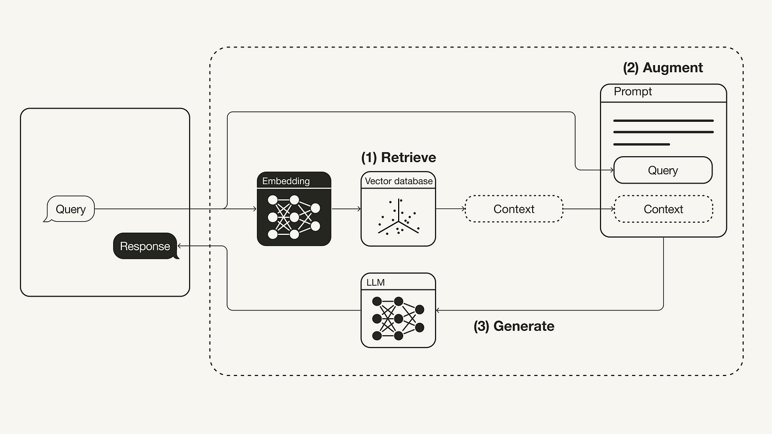
Chunking Flow
Retrieval-Augmented Generation (RAG):

Slide 26
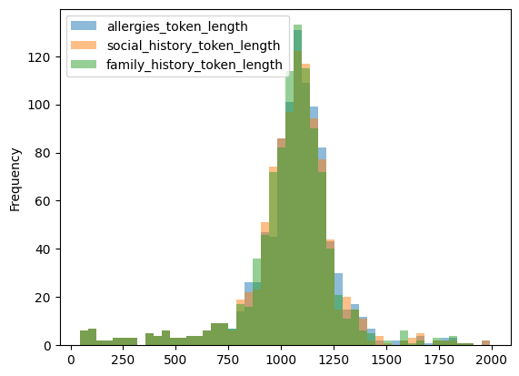
Chunking Flow
Restricting token limit:
Using set amount of chunks with a fixed size
Mitigates the problem of exceeding input tokens
Raises uncertainty of picking the right chunk
Utilization of Semantic and Lexical Retrieval
Discussed in-depth next:

Slide 27
Chunking Flow
Semantic based Retrieval:
Utilizes an embedding based model, vector store (optional)
Vector based representation learnt via transformers or NN architecture
Searching via a vector representation of text via cosine similarity
Captures the contextual meaning of text, but needs to have domain-specific in-depth knowledge
Testing with models like mxbai, sfr_mistral, bge-m3

Slide 28
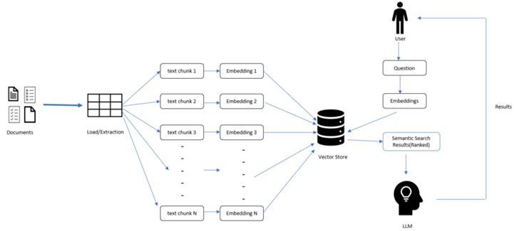
Chunking Flow
Semantic based Retrieval:

Slide 29
Chunking Flow
Lexical based Retrieval:
Utilizes similarity based on frequency and arrangement of individual words
Similar to techniques like TF-IDF
Effective for surface-level similarities, struggles with context understanding
Operates at the word level, and computationally inexpensive
Testing with RankBM25, and LuceneSearcher (pyserini implementation)

Slide 30
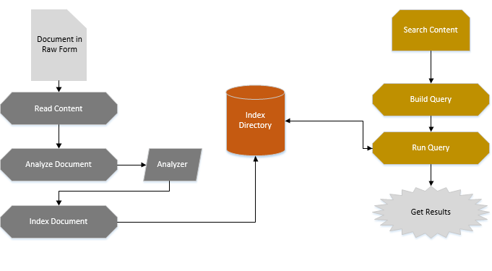
Chunking Flow
Lucene Search (pyserini):

Slide 31
Chunking Flow
Conditional chunking and retrieval:
Tokenization of processed note, via standard mistral tokenizer
No need of going through chunking and retrieval, if tokens are less than 2500
For other case, need to go for chunking and retrieval to restrict the maximum cap

Slide 32
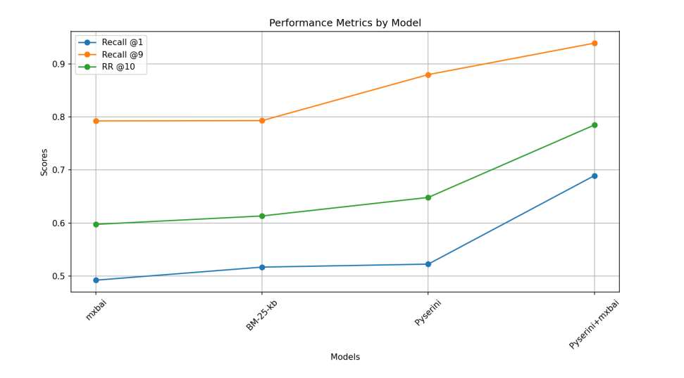
Chunking Flow
Decision for Union of chunks:

Slide 33
Chunking Flow
Conditional chunking and retrieval:
Union of semantic and lexical chunks
Both to give at maximum of 10 chunks of 512 characters, capping at about 2500 tokens
Implementation of Semantic chunking, but computationally expensive

Slide 34
Chunking Flow
Semantic Chunking:
Semantic chunking technique has also been implemented
Smaller initial chunks, fusion of chunks based on semantic meaning
Needs to create embeddings twice, first for fusion based on semantic meaning
Second for comparison with the user query
Currently not utilized due to GPU and inference time constraints

Slide 35
Section 6:
Prompt Engineering

Slide 36
Prompt Engineering
Practice of designing and refining prompts(questions or instructions) to elicit specific responses from AI models.
Useful in getting desired results for single-turn responses
Key elements of a prompt:
System prompt / Instruction
Query
Input data
Output indicator

Slide 37
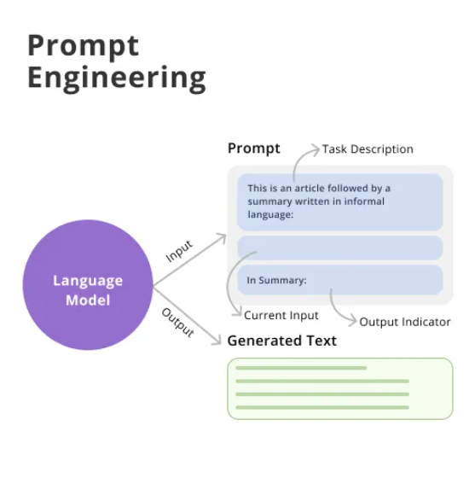
Prompt Engineering
Applied techniques in our model:
Role Playing
Zero Shot Prompting
One Shot Prompting

Slide 38
Prompt Engineering
Role Playing Prompt:
You are an expert in oncology, fully versed in all aspects of cancer progression, chemotherapy, its side effects, and the relevant medical terminology. Additionally, you possess exceptional skills in extracting information based on a provided JSON schema and crafting accurate JSON objects. When presented with a clinical note, your task is to analyze it and populate the given schema with information extracted directly from the note, strictly adhering to the question’s requirements. If the clinical note lacks the necessary information, respond with an appropriate response according to the schema’s default properties. Remember,
the original schema should not be returned as is. When the label is set false by you, there is no need to provide any details regarding that.

Slide 39
Prompt Engineering
Zero shot vs One shot Prompting:
Prompting Technique | Description
Zero-Shot Prompting | The LLM cannot look at any examples from the target class during inference
One-Shot Prompting | The LLM observes only one example from the target class during inference
k-Shot Prompting | The LLM observes k-examples from the target class during inference

Slide 40
Prompt Engineering
One shot vs zero shot Prompting:
<|system|>
[SYSTEM PROMPT]
Schema:
‘‘‘json
[SCHEMA]
‘‘‘
<|assistant|>
[ASSISTANT TEXT-1]
<|user|>
Example Text:
[EXAMPLE TEXT]
Query:
[QUERY]
Example JSON:
‘‘‘json
[EXAMPLE JSON]
‘‘‘
<|assistant|>
[ASSISTANT TEXT-2]
<|user|>
Actual Text:
[ACTUAL TEXT]
Query:
[QUERY]
<|assistant|>
<|system|>
[SYSTEM PROMPT]
Schema:
‘‘‘json
[SCHEMA]
‘‘‘
<|assistant|>
[ASSISTANT TEXT]
<|user|>
Actual Text:
[ACTUAL TEXT]
Query:
[QUERY]
<|assistant|>

Slide 41
Prompt Engineering
Problems associated with k-Shot Prompting:
For the tasks which have large amount of input and output tokens, following can occur:
Reaching token length limit (8k tokens for Mistral v0.2 7b) leading to truncation of input tokens
Examples causing contamination, contributing to hallucinations
Mitigation by providing one negative example
Mis-interpretation of task as producing inputs and outputs (LLM Infinite Loops)

Slide 42
Progression JSON schema:
JSON with non-trivial and trivial data
{
"$schema": "http://json-schema.org/draft-07/schema#",
"type": "object",
"properties": {
"cancerType": {
"type": ["string", "null"]
},
"progression": {
"type": "object",
"properties": {
"hasDiseaseProgressed": {
"type": "boolean",
"default": false,
"description": "Indicates whether the disease has progressed since the last assessment."
},
"progressionDate": {
"type": ["string", "null"],
"format": "date"
},
"progressionDetails": {
"type": "array",
"items": {
"type": ["string", "null"],
"description": "Details of the progression."
}
}
},
"required": [
"hasDiseaseProgressed",
"progressionDate",
"progressionDetails"
]
}
},
"required": ["cancerType"]
}
{
"cancerType": "metastatic cancer",
"progression": {
"hasDiseaseProgressed": true,
"progressionDate": "8/2/2023",
"progressionDetails": [
"New rib lesion and C4 lesion on PET CT",
"Patient with PIK3CA mutation on guardant testing",
"Initially treated with verzenio and letrazole",
"Changed to letrazole after noticing signs of progression with new rib met",
"Completed radiation to 9th rib and C4",
"Patient on pamidronate for bone metastases",
"Repeat PET CT in 6 months",
]
}
}
{
"cancerType": "colon cancer",
"progression": {
"hasDiseaseProgressed": false,
"progressionDate": null,
"progressionDetails": []
}
}

Slide 43
Section 7:
Post-processing & Results

Slide 44
Post-processing
Separation of JSON data from the supporting text from the LLM response
Storage of JSON as objects
Storage of text as a attribute of object
Meta-data of prompt
Context (stored only if chunks are made)
Context tokens
JSON post-processing
Check if it is a valid JSON
Check if it is adhering to Schema provided

Slide 45
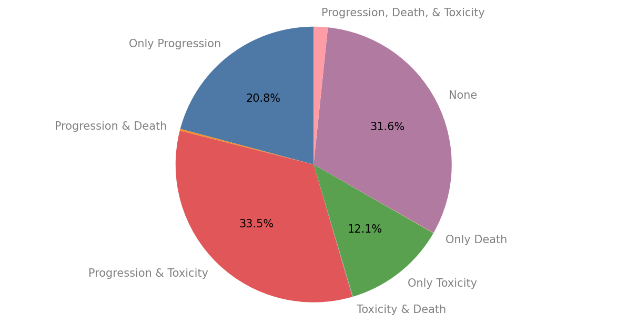
Results
In total, about 4,000 patients and 60,000 notes has been processed

Slide 46
Results
Invalidity of JSON (out of 60k notes):
Not adhering to Schema:
Death: 0
Progression: 650 [None is not of type boolean: 497, Others: 153]
Toxicity: 116 [Different type than expected, got list instead of string or None]
Invalidity Reason | Death | Progression | Toxicity
Only Text | 0 | 53 | 8
Invalid JSONs | 1 | 264 | 6
Total | 1 | 307 | 14

Slide 47
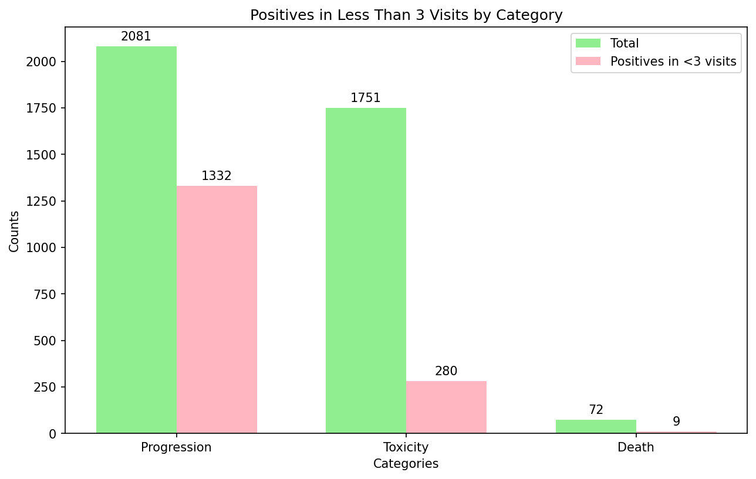
Results

Slide 48
Abdullah Bin Faiz
Work Done till MDR

Slide 49
Work Done till MDR
Inference Speeds
Looked into multiple libraries to boost up speed in Large Language Models (LLMs)
Compiled results of various implementations and settled on an approach
TensorRT-LLM proved viable for not just our project, but for DL team as a whole
Libraries that were tried include, but are not limited to:
TensorRT-LLM
Optimum
PyTorch 2.0 (Flash Attention, compile, etc.)

Slide 50
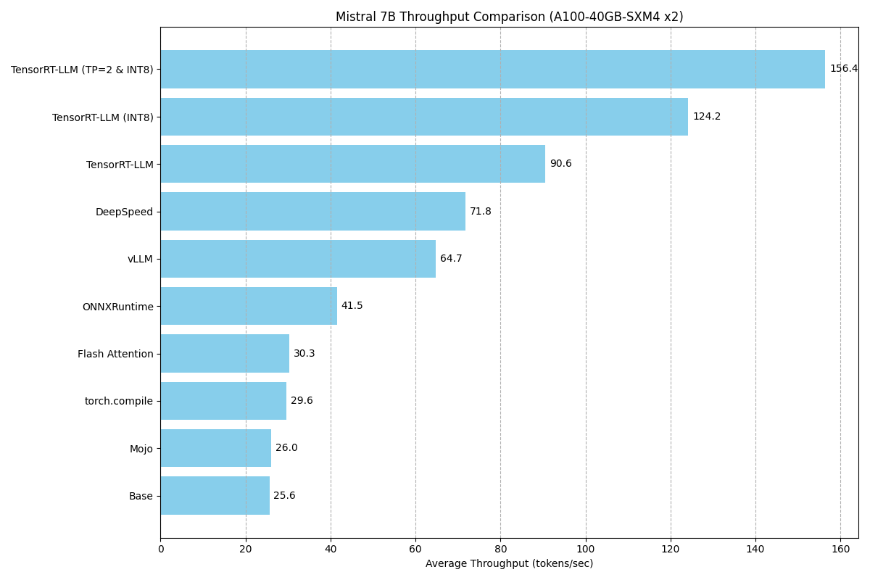
Work Done till MDR
Results

Slide 51
Work Done till MDR
Large Language Models
Experimented with different LLMs to check which one performed the best for our use case
Includes but is not limited to:
Mixtral 8x7B
CodeLlama
Phi-2
Gemma

Slide 52
Work Done till CDR

Slide 53
Work Done till CDR
TensorRT
Generalized framework for all deep neural networks (not just LLMs)
ONNX Runtime implementation
Set up a proof-of-concept for TensorRT
Implement and convert Sentence Embeddings model into ONNX graph
Results were not exemplary but was noticeable to a good degree

Slide 54
Work Done till CDR
Cancer Notes Preprocessing
Pipeline established with Asad Afzal to preprocess all Cancer notes
Intuition was to have a ready-made dataset of Cancer notes to process in future projects
Approx. 250,000 Cancer notes (C18, C34, C50, C61, C90) preprocessed and stored in MongoDB + 2 backups

Slide 55
Work Done till CDR
Remove short lines (less than 6 words)
Used in Cancer Labels Extraction
Gather notes from Spark DB
Remove Non-ASCII Characters
Remove HTML headers
Remove unneeded sections
Extract differential text from sequential notes
Add preprocessed notes to database

Slide 56
Work Done till CDR
Cancer Notes Processing
Preliminary steps taken to check applicability of Cancer notes processing on LLM
Extremely small sample of notes selected
Devised initial prompt and schema to capture everything Cancer related
Initial results proved promising, but more work needed to be done

Slide 57
Work Done till CDR
Cancer Notes Processing
Selected Breast Cancer notes on basis of quantity
Research on how Breast Cancer can be detected
Attributes chosen for capturing information from notes (included but not limited to):
Tumors
Staging
Grade
Biomarkers

Slide 58
Work Done till CDR
Cancer Notes Processing
Evaluations carried out with Momin and Muhammad
Evaluated in two iterations
First iteration focused on generalizability
Second iteration focused on specialization
Results discussed by Muhammad Siddiqi

Slide 59
Work Done till CDR
More LLMs
Two LLMs were focused on
Solar-Nous 10.7b performed better than Mistral 7b with initial prompt engineering
Mixtral 2x7b performed remarkably better than Solar-Nous
Currently being used in Asad's project
Neither could be used effectively
Some notes took up more context than the availably memory and caused OOM errors

Slide 60
Work Done till CDR
Nvidia H100 Server System
API endpoint of Mistral 7B currently being used by multiple projects (CureDoc, Notes Processing, etc.)
A need to load larger models for quality responses
Prepared a system configuration designed primarily for LLMs usage (beneficial for DL Team)
Supports not only H100/H100 NVL but nay PCIe-based server graphics card

Slide 61
Work Done till CDR
AMD MI300/X Server System
Option for AMD-specific hardware as it boasts significant amount of memory for our use case
Little open source documentation on MI300/X
Mostly prebuilt systems in the market
System recommended for Nvidia H100/NVL usable here

Slide 62
Work Done till CDR
Renting a Server System
Most (if not all) rentable servers use A100 and H100
Costs vary marginally between companies
Amazon AWS, Microsoft Azure, Google, and Coreweave analyzed thoroughly
Costs compared with locally built system (worst-case scenarios assumed)

Slide 63
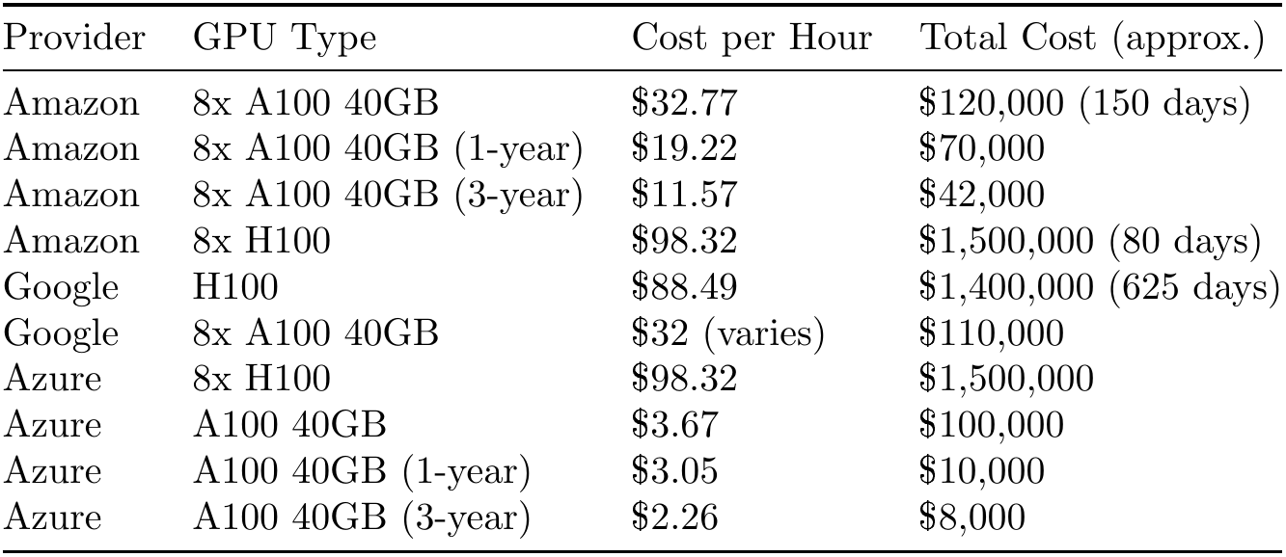
Work Done till CDR

Slide 64
Work Done till CDR
Code Review
Initiative to guide the AI department on a baseline that makes code documented properly
Guidelines prepared following multiple PEP standards:
Docstrings
Exceptions
Standard Naming Conventions
Indents / Line Breaks

Slide 65
Arbaz Khan Shehzad
Work Done till MDR

Slide 66
Chunking of Notes
Why?
Our approach is to provide a schema for specific information like allergies, social_history etc.
Passing whole note to extract some specific information is unnecessary.
LLMs have a limited context window, making it unrealistic to provide all data simultaneously.
Chunking ensures that only relevant context is sent to the LLM, enhancing the efficiency and relevance of the responses generated.

Slide 67
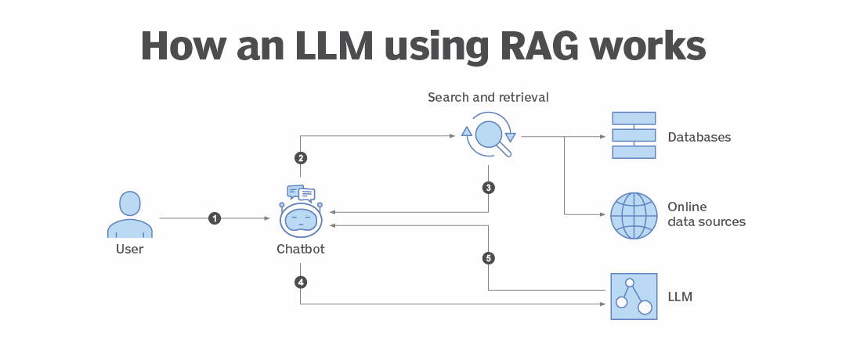
Retrieval Augmented Generation

Slide 68
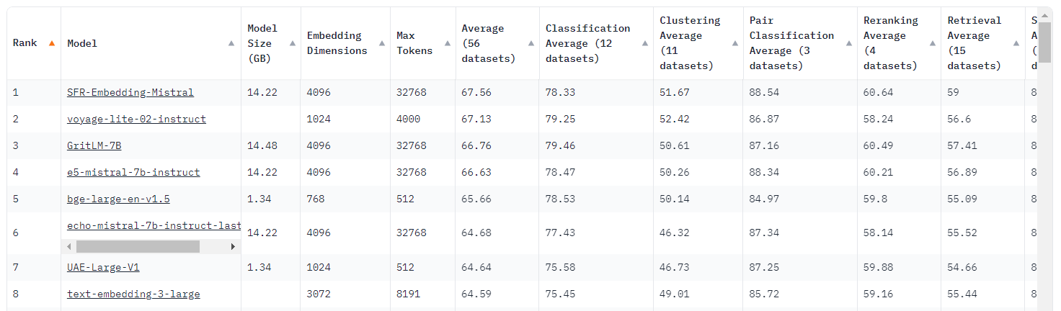
Embedding Models

Slide 69
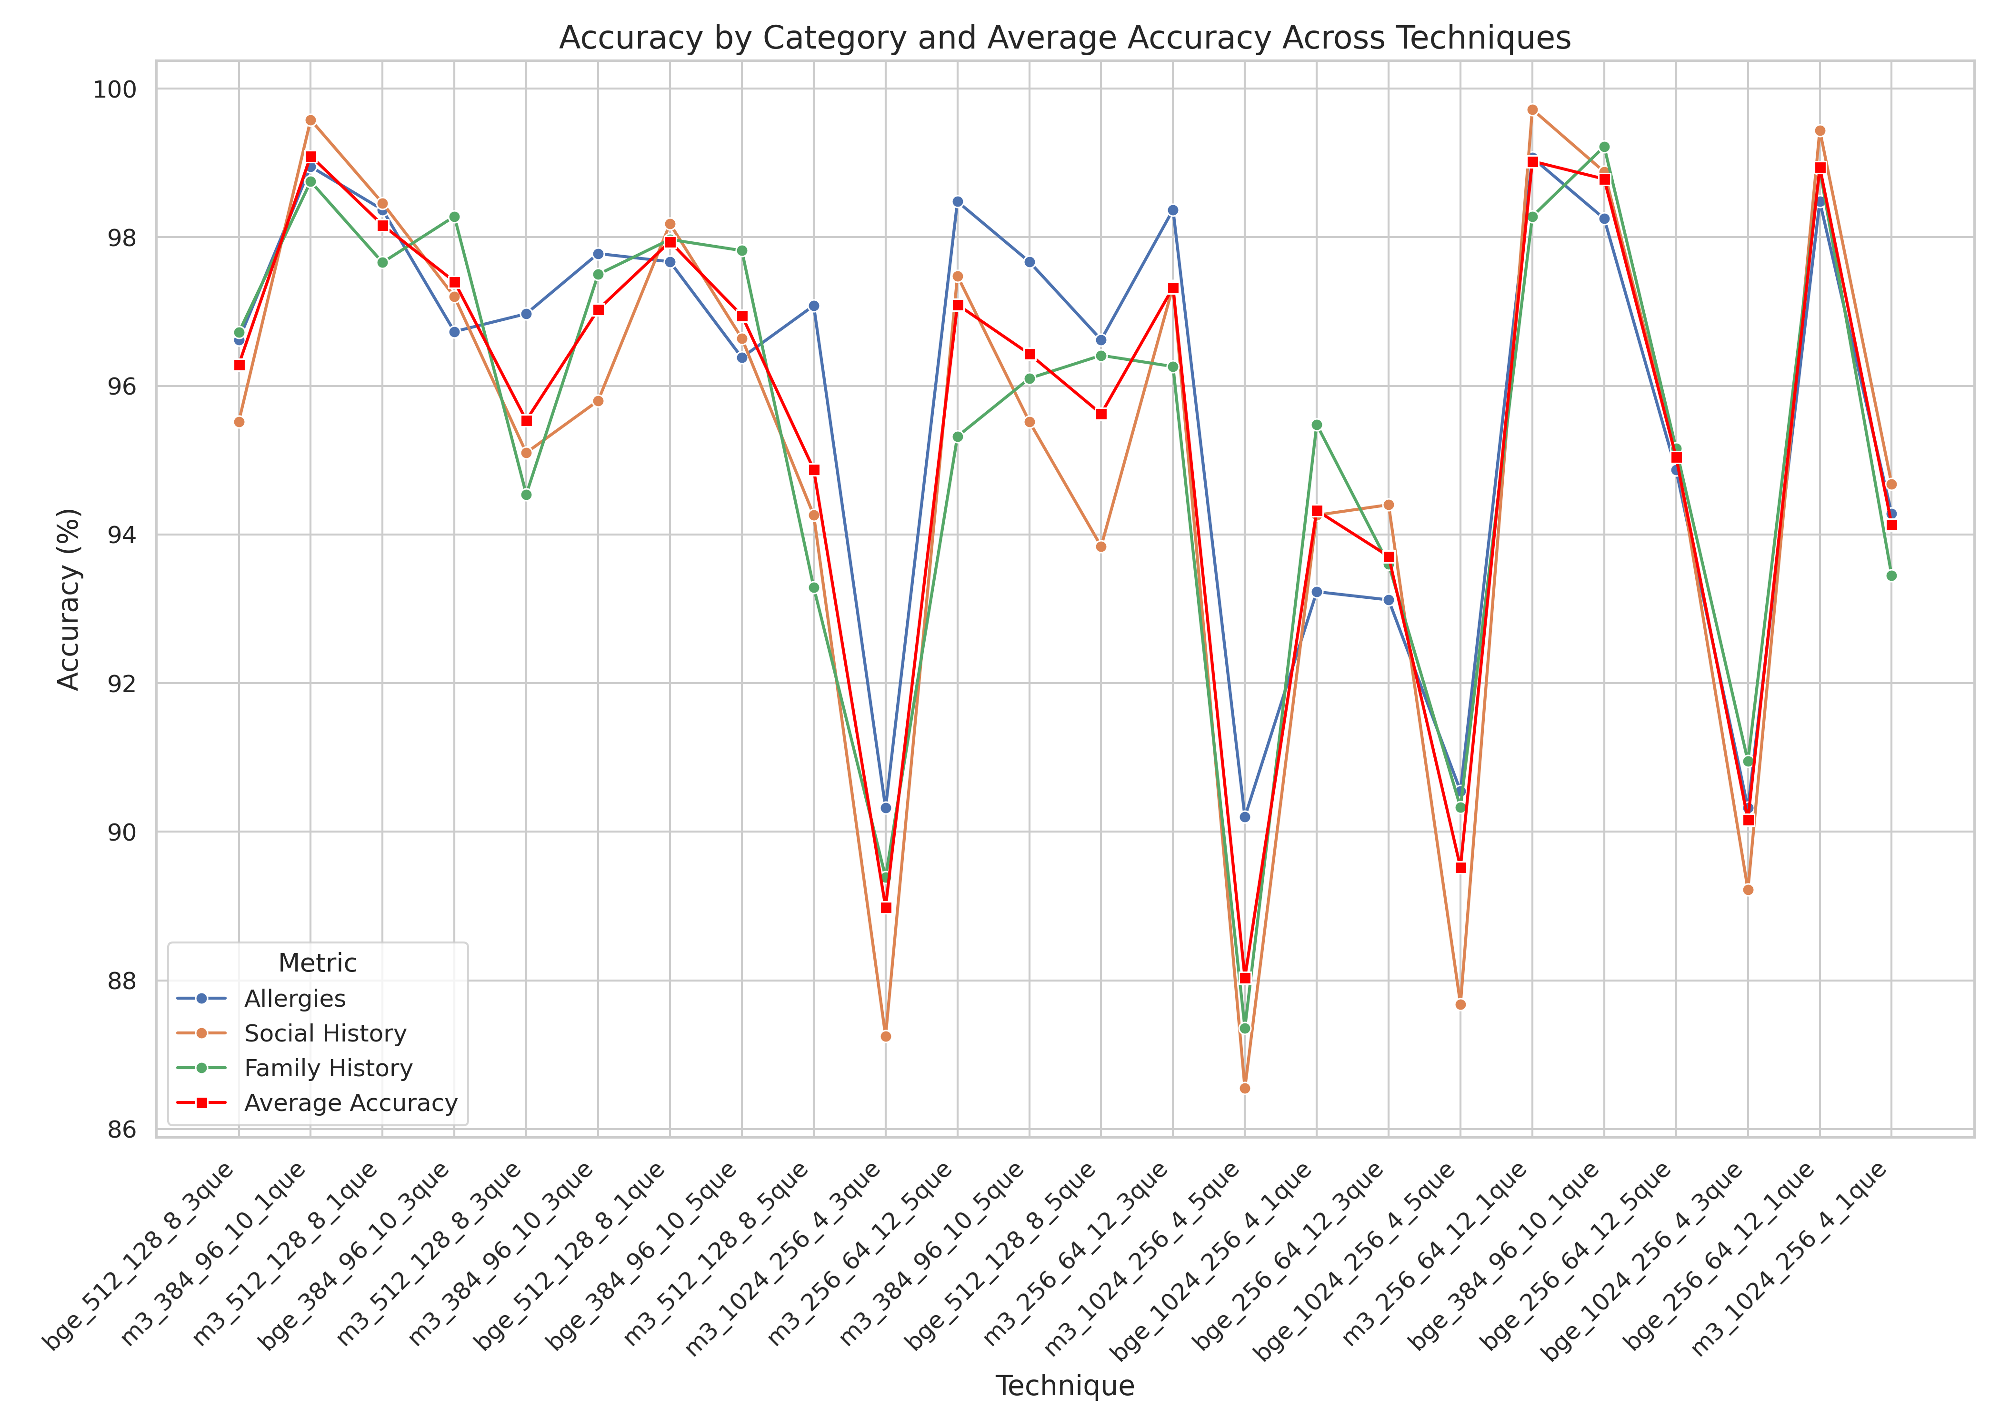
Results of Chunking

Slide 70
Work Done till CDR

Slide 71
Oncology Based approach’s Code and its Analysis
The original code focuses on two main stages
Annotation
Feature Extraction

Slide 72
Annotating the notes
For the annotations we use:
NCBO smart annotator API
Annotations configurations are as follows
Max words: 50
Longest only: True,
Score: cvalue (For extraction of terms within nested longer terms)
Exclude Numbers: True (date is manually picked by regex)
Score Threshold: 0 (For cvalue threshold)

Slide 73
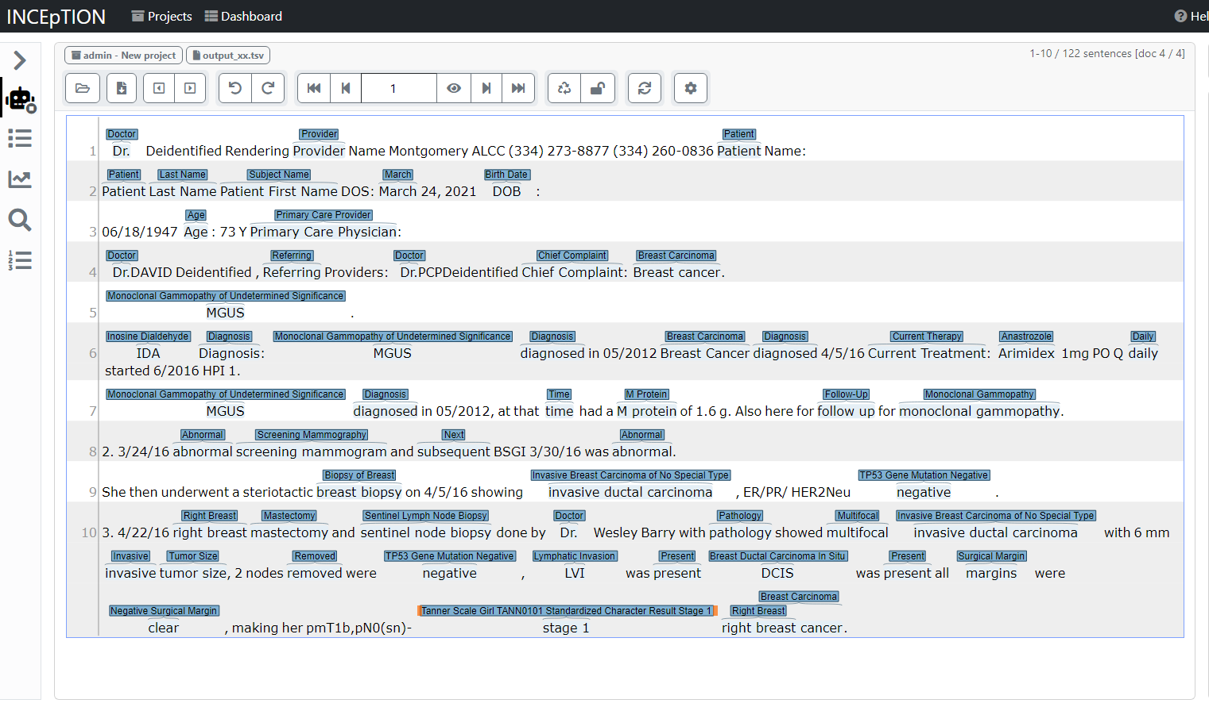
Visualizing Annotations

Slide 74
Feature Extraction
The required output
Stage
TNM
Grade
Tumor
Performance
Biomarkers
SCLC
Risk
Gleason

Slide 75
Feature Extraction
Methodology:
NCIT ontology
Identify parent classes of each entity in the annotated note
Mapping the entities using their parent classes
Converting it to suitable output json/dict format
If everything fails we try with some specific regex terms matching

Slide 76
Revamping the code
Modularity in the code
Graph
TSV 3.3
Max word limit to 500 words (improves annotation time)
Removal of extremely nested MongoDB dependencies
Removal of unnecessary instantiation of classes(improves time)

Slide 77
Effects After Revamping of Code
Time Complexity Reduced
Dependency on MongoDb Reduced
Increased Modularity and Reusability of code

Slide 78
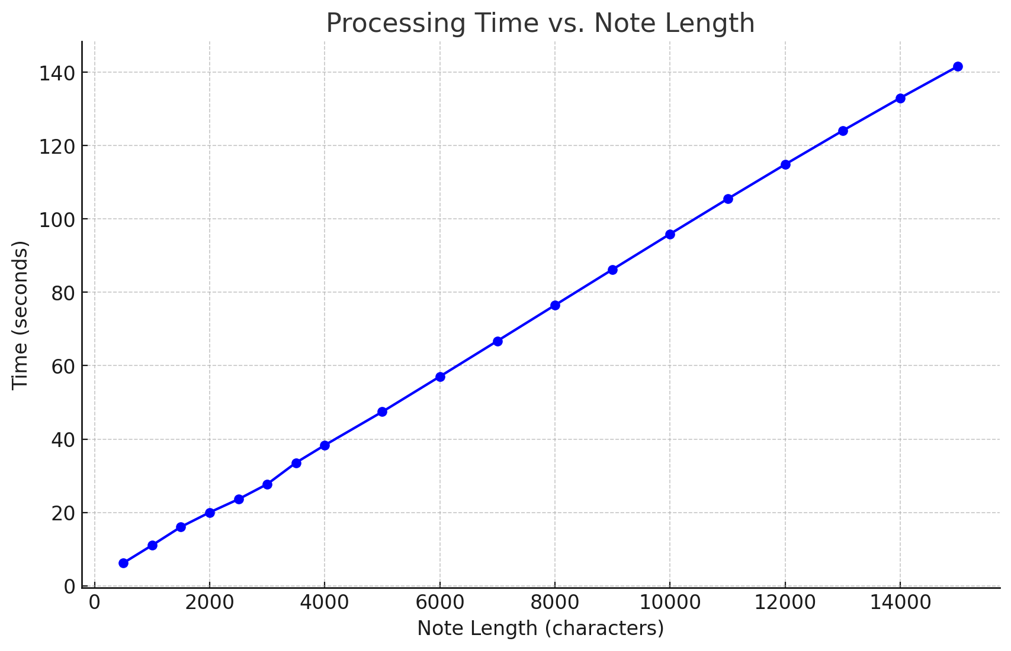
Testing it Against LLM-based approach
Ontology based approach processes linearly with increase in word count as shown in figure, while LLMs are not dependent on words (Although it is limited by max tokens)

Slide 79
Momin Tariq
Work Done till MDR-1

Slide 80
Data Preparation
Why we needed to prepare data?
To review Mistral’s performance on different practices
Make a quantitative analysis of Mistral’s performance
Compare Mistral’s performance with that of GPT-4
Curate data for finetuning
Approach used for dataset preparation
Extract notes of top 50 practices of CureMD
Extract notes of 20 different patients from each practice randomly
Performed notes processing on extracted notes
The extracted notes were processed by both Mistral7b and GPT-4 using API
Reviewed and compared the JSONs extracted by both the above models

Slide 81
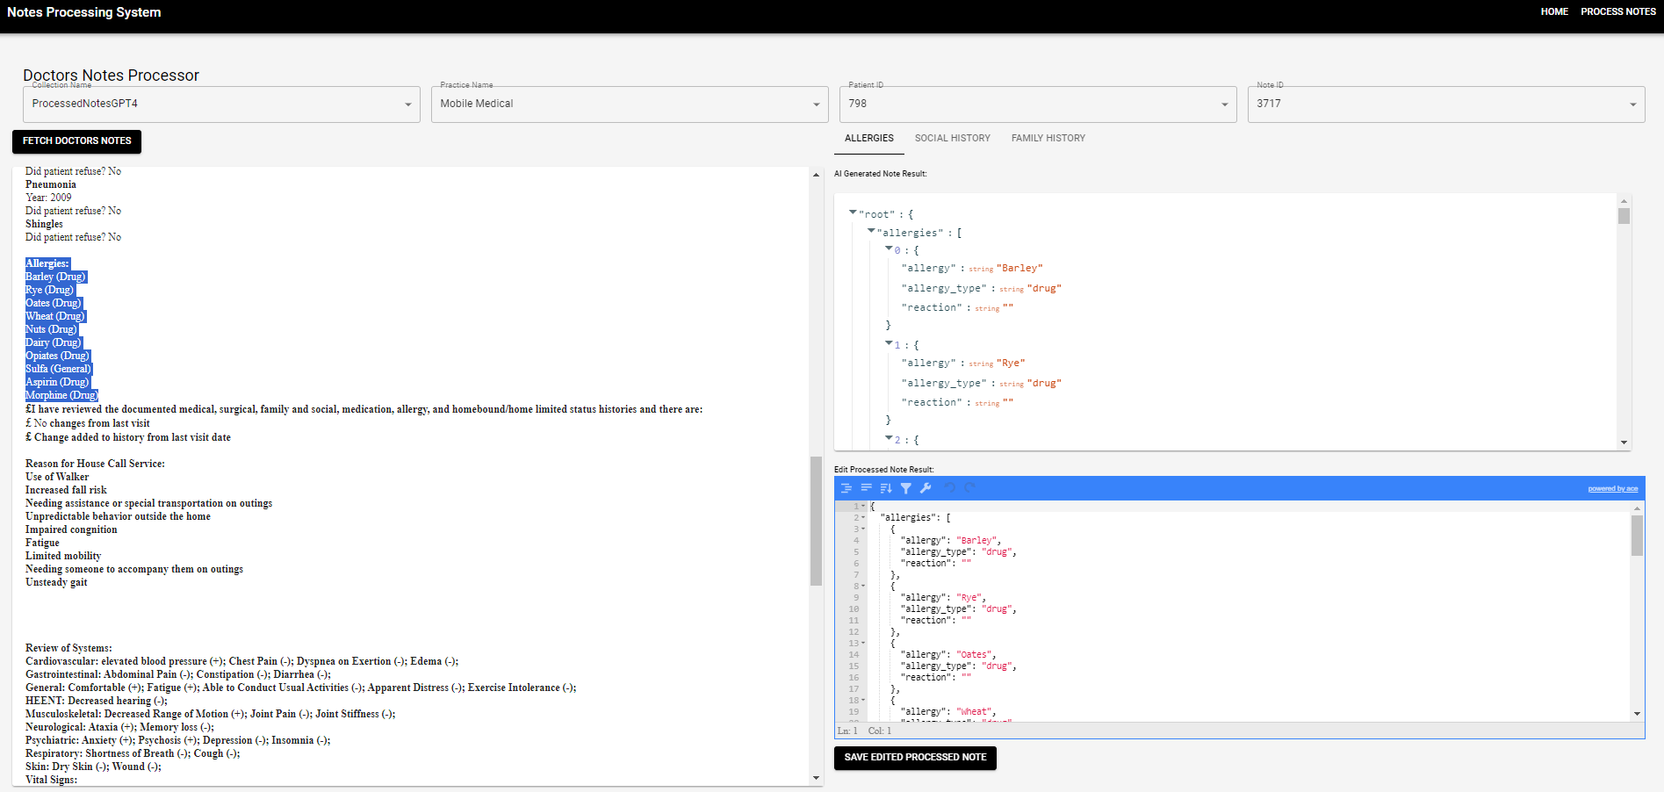
SPA for Reviewing Asthma Notes
Application for reviewing responses and annotating data for finetuning:
Made an application using React and Django for reviewing LLM’s responses easily
App displays Notes along with responses in different tabs for allergies, family history and social history
Provides an editable box for fixing the response, this edited response was then used for finetuning

Slide 82
Annotating Notes for Finetuning
Each of 5 resources spent 3 days to manually verify information from Notes
To make JSON Valid
Make sure JSON adheres with schema provided
Make sure no information is missed
Make sure no extra information was added
Make sure context provided is correct

Slide 83
Revamping Medical Mind
Earlier Medical Mind application was designed for Diabetes
Made necessary changes to the application to make it generic and adaptable for all diseases
Decided on a strict schema for database
Added a dropdown function on the frontend to add new diseases
Made necessary changes in the business logic layer to accommodate other diseases

Slide 84
Work Done till CDR

Slide 85
Schema Design For Oncology Notes
Decided to extract information related to following:
Stage
TNM
Tumor Information (findings, size, body part/organ, laterality)
Grade
Performance (ECOG, KARNOFSKY, LANSKY)
Biomarkers
HR (Estrogen, Progesterone)
HER2
CA15-3
CA27-29
TMB
MMR
MSI
CEA
PD1/PDL-1
Mutations (PIK3CA, BRCA, CDK4, CDK6, mTOR, PARP)

Slide 86
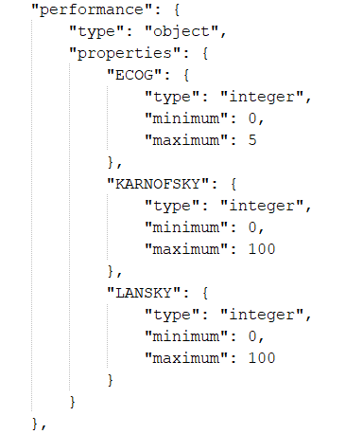
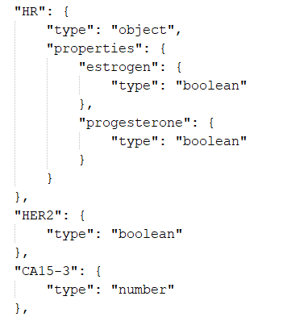
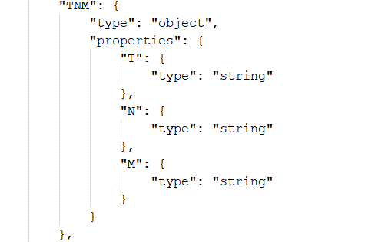
Schema Example

Slide 87
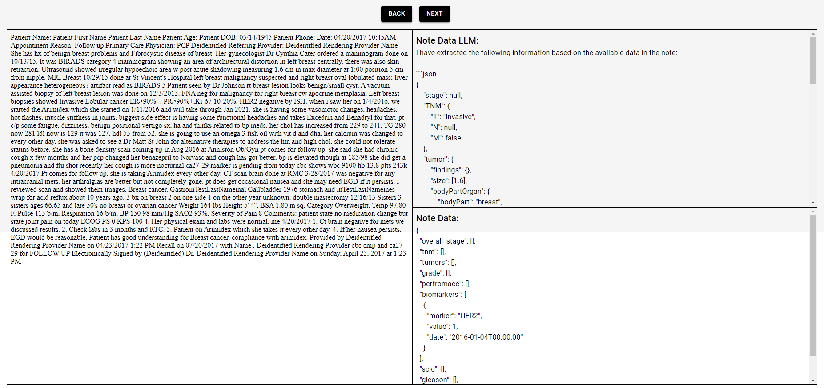
SPA For Reviewing Cancer NOTES
Application for reviewing responses and differences between Ontology and LLM based approaches:
Application was made using React and Django

Slide 88
Adjustments Made To Brainy Games
Made adjustments to the frontend
Change the puzzle generator for crossword
Real-time crossword generation
Crossword now adheres to UK based Grid format
Added Timer function to all games
Added feature to auto save games after set time

Slide 89
Muhammad Siddiqi
Work Done till MDR

Slide 90
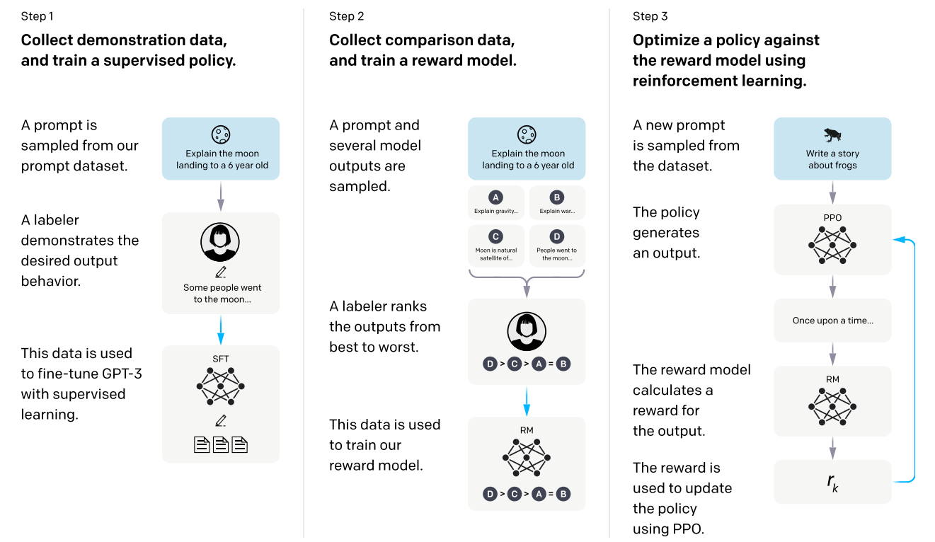
Supervised FineTuning
Reference: https://proceedings.neurips.cc/paper_files/paper/2022/file/b1efde53be364a73914f58805a001731-Paper-Conference.pdf

Slide 91
Supervised FineTuning
Step 1: Curate the dataset of high quality LLM outputs.
Step 2: Feed the data to the model
Step 3: In each training iteration, sample from the dataset is used
In SFT, Model Replicates the behavior shown in the curated dataset
Next Token Prediction remains the primary task of the model.
Generic Fine Tuning in Deep NNs makes models Narrow Experts.
It does not happens in SFT.

Slide 92
Resource Limitations
We had two A100 GPUs, each having 40GB VRAM
Our goal was to finetune Mistral_v0.2 7B model for Asthma patients' notes
Resources were not enough for simple SFT with Transformers library
We needed to accelerate training and make optimizations
A few extremely popular approaches are using
Accelerate
DeepSpeed
Zero1, Zero2, Zero3

Slide 93
Our Fine Tuning
<s> [INST] <<SYSTEM PROMPT>>
Schema:
```json
<<JSON SCHEMA>>
```
Input Text:
Retreived part of the note: 1 a. Never Total Score Allergies Allergy: NKDA Current Medications Eliquis 5 MG Oral Tablet: 1 Tablet(s) 2 times daily , Start 09/20/2021, Qty 60 Tablet(s) For 30 Day(s) Refill 5 Lexapro 20 MG Oral Tablet:
Retreived part of the note: 2 Hematology: Denies Easily Bruised and Spontaneous Bleeding Lymphatic: Denies Enlarged Lymph Node - General and Tender Lymph Node Musculoskeletal: Denies Decreased Range of Motion , Joint Pain , Joint Swelling , Muscle Weakness and Myalgia Neurological
Query: What Allergies or allergies are mentioned in the text? [/INST] ```json{“allergies”:[]}```</s>
<s> [INST] <<SYSTEM PROMPT>>
Schema:
```json
<<JSON SCHEMA>>
Relevant Context:
<<Relevant Context>>
Query: <<Query>>
[/INST]
<<Output>>
</s>

Slide 94
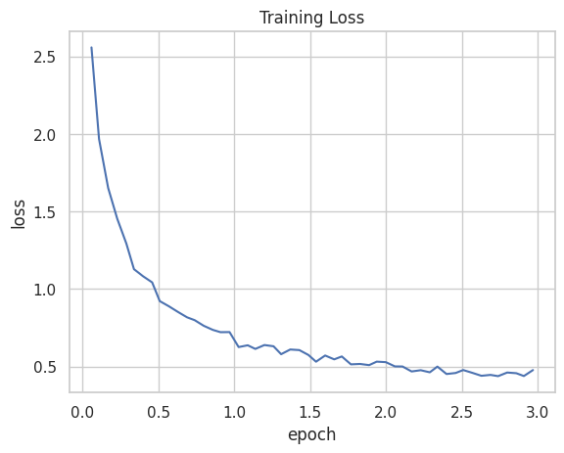
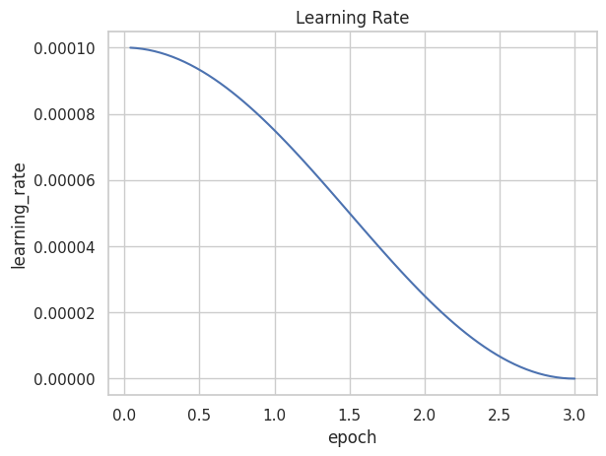
Our Fine Tuning
Train Time: 51 mins
train_loss: 0.3476560233434041
VRAM: 32-35 GBs on Two A100 GPUS with 40GB VRAM each

Slide 95
Our Fine Tuning
<s> [INST] <<SYSTEM PROMPT>>
Schema:
```json
<<JSON SCHEMA>>
```
Input Text:
Retreived part of the note: 1 a. Never Total Score Allergies Allergy: NKDA Current Medications Eliquis 5 MG Oral Tablet: 1 Tablet(s) 2 times daily , Start 09/20/2021, Qty 60 Tablet(s) For 30 Day(s) Refill 5 Lexapro 20 MG Oral Tablet:
Retreived part of the note: 2 Hematology: Denies Easily Bruised and Spontaneous Bleeding Lymphatic: Denies Enlarged Lymph Node - General and Tender Lymph Node Musculoskeletal: Denies Decreased Range of Motion , Joint Pain , Joint Swelling , Muscle Weakness and Myalgia Neurological
Query: What Allergies or allergies are mentioned in the text? [/INST] ```json{“allergies”:[]}```</s>
<s> [INST] <<SYSTEM PROMPT>>
Schema:
```json
<<JSON SCHEMA>>
```
Example Text:
<<EXAMPLE TEXT>>
[/INST]
[INST]
Example JSON:
```json
<<EXAMPLE JSON>>
```
[/INST]
[INST]
Input Text:
<<INPUT TEXT>>
Query: What Allergies or allergies are mentioned in the text? [/INST]
<<Output>>
</s>

Slide 96
Results
Following are the results obtained from the Capstone Model
{
"Invalid JSONs Zero Shot": 10,
"Invalid JSONs One Shot": 2,
"Invalid Schema Zero Shot": 220,
"Invalid Schema One Shot": 194,
"Wrong info Zero Shot": 24,
"Wrong info One Shot": 15,
"Missed info Zero Shot": 166,
"Missed info One Shot": 130,
"Hallucinated info Zero Shot": 31,
"Hallucinated info One Shot": 28,
}

Slide 97
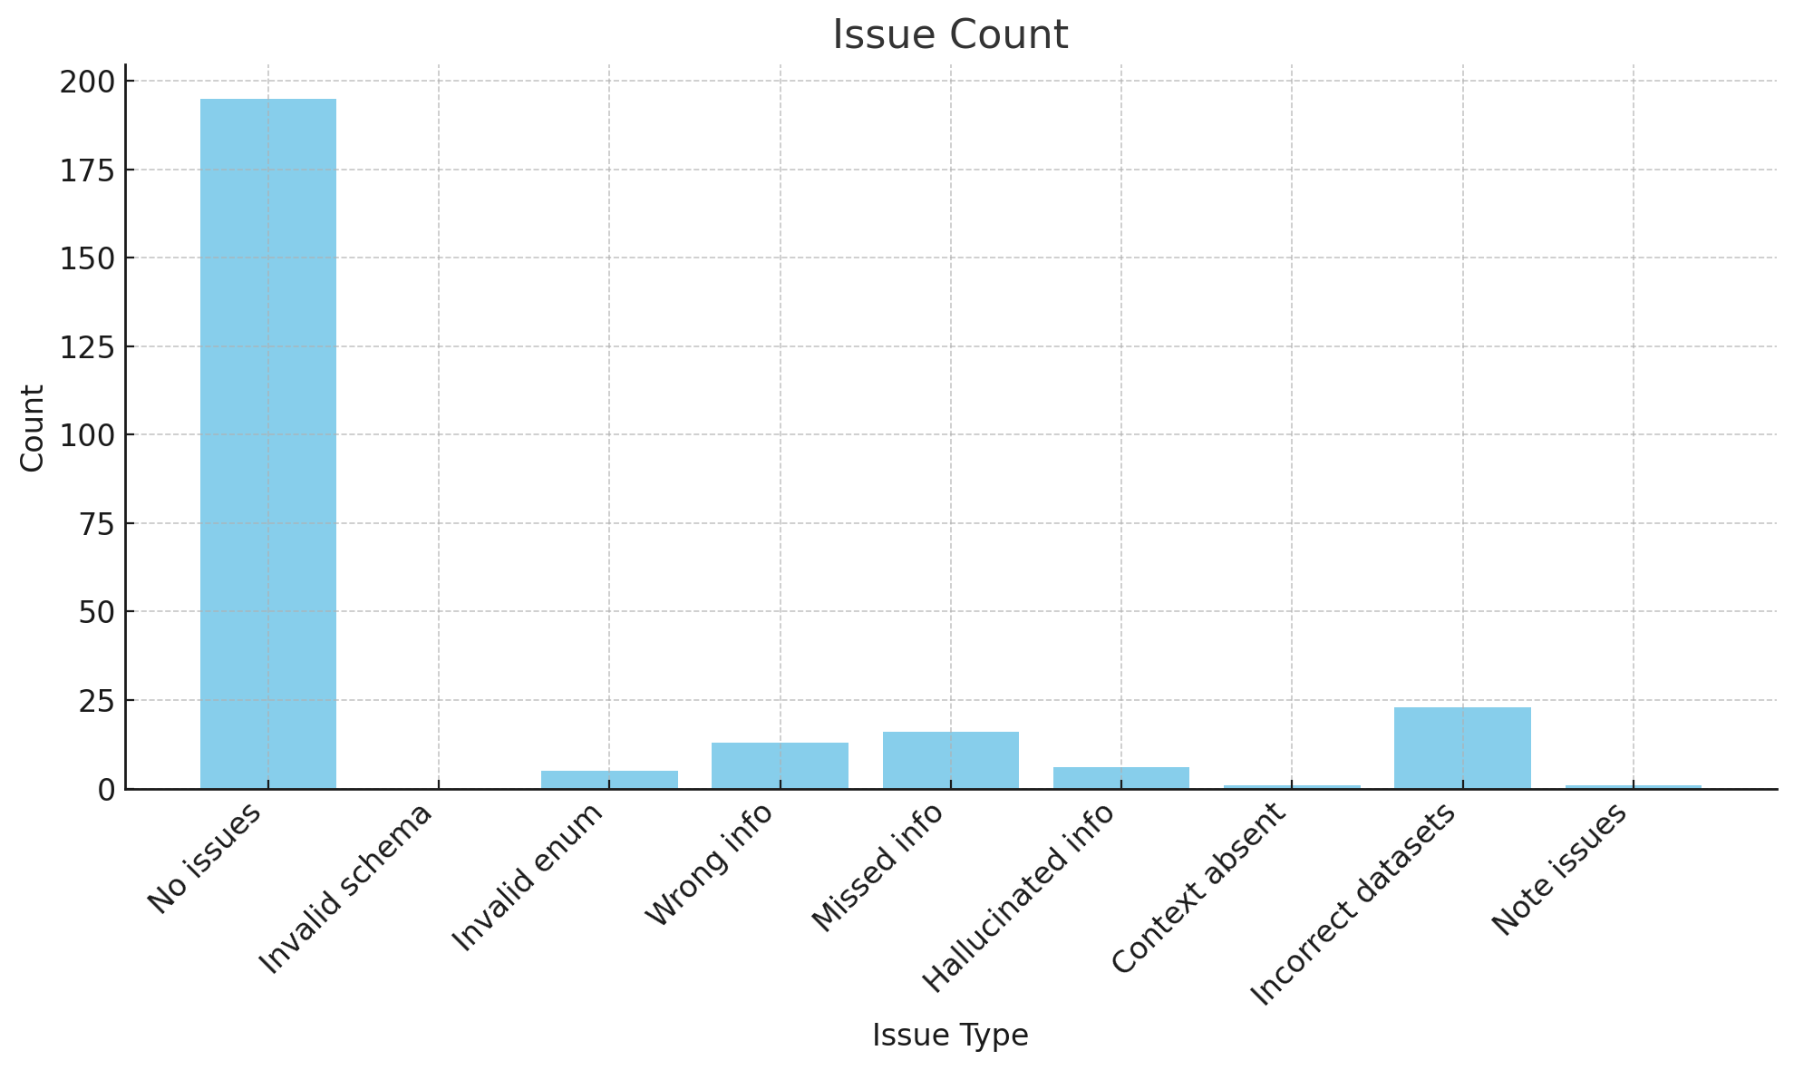
Results
Following are the results obtained from the Fine Tuned Model (Test set)
{
"No issues": 195,
"Invalid schema": 0,
"Invalid enum": 5,
"Wrong info": 13,
"Missed info": 16,
"Hallucinated info": 6,
"Context absent": 1,
"Incorrect datasets": 23,
"Note issues": 1
}

Slide 98
Work Done till CDR

Slide 99
Pipeline for FineTuned Model
We have ~160K Asthma notes
Notes were filtered based on ref_date
Created Pipeline to process these notes

Slide 100
Pipeline
Extracting note form DB
Creating Chunks based on queries
Applying Chat Template
Inference using LLM
Storing results in DB

Slide 101
Evaluation on Oncology Notes
We tried to perform inference on Oncology notes using the new FineTuned Model
Model was not able to perform well (possibly due to context length, prompt, etc.)
Model was not able to understand the new schemas (as they were not provide at the time of FineTuning)

Slide 102
Oncology Notes Evaluations
Notes were process using base LLM and Oncology Based system
Manual Evaluation of 200 notes was performed
Two iterations of evaluations were performed

Slide 103
Evaluation Iteration 1
Metric | LLM | Ontology
Correct | 43 | 21
Missing | 20 | 36
Wrong | 34 | 37
Hallucinated | 32 | —
Empty | 11 | 55
Invalid JSON | 21 | —
Invalid Enum | 13 | —

Slide 104
Evaluation Iteration 2
Category | LLM |  | Ontology
 | Correct | Incorrect | Correct | Incorrect
Stages | 34 | 6 | 35 | 5
TNM | 32 | 8 | 32 | 8
Tumor | 27 | 12 | 31 | 9
Grade | 33 | 7 | 33 | 7
Performance | 35 | 5 | 35 | 5
BioMarkers | 35 | 5 | 13 | 27

Slide 105
Evaluations Discussion
In iteration 1, LLM performed remarkably well
In iteration 2, both system produced similar results
In Biomarkers, LLM was producing far better results compared to the Ontology based system

Slide 106
Questions?

